Slide 1
Professional
Dress Code
JEBAN IGNESH - 11963

Slide 2
Importance Of Dress Code.
Acceptable and Unacceptable Dress Code.
Why should employees follow appropriate dress code in the workplace?

Slide 3
Importance of Dress Code
First impression do matter!..and are lasting.
Dress sends a message about who you are.
Dress could have a big impact on your success in the workplace.
Dress affects your credibility as a person and professional.

Slide 4
Acceptable Dress Code
In Corporate, all of the company’s follows some kind of dress codes.
In our company follows and maintain two kind of dress codes.
1)Business Formals.
2) Business Casuals.

Slide 5
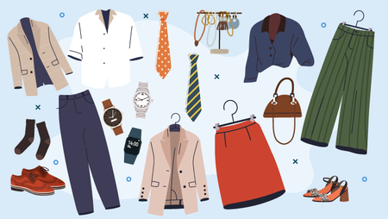
Business formals:
Suits, pantsuits, and formal dresses make up this dress code, one that's common in traditional, conservative working environments.
Business formal means business, and items that show personality and vibrancy are far less common with this attire.

Slide 6
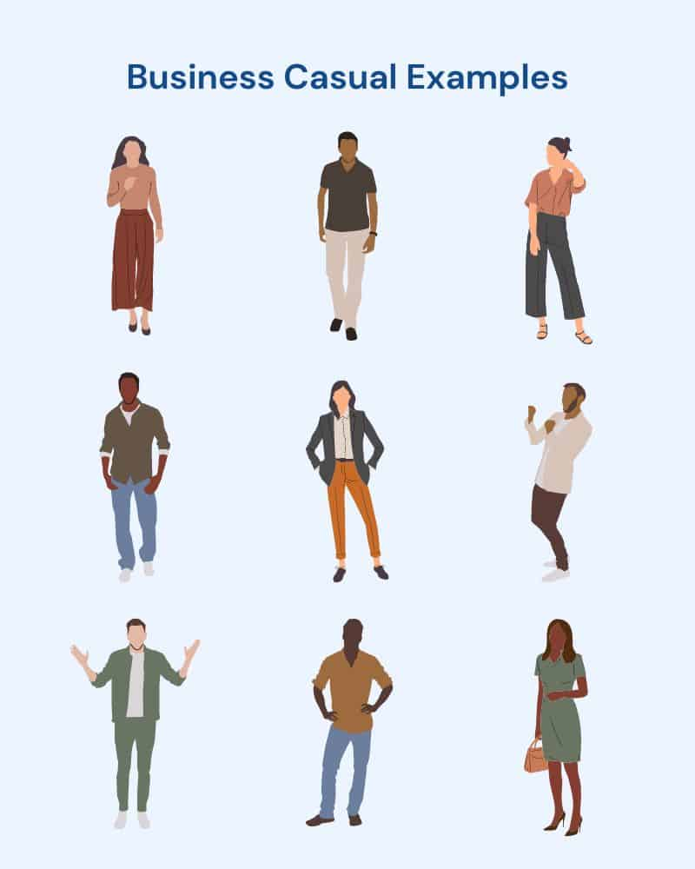
Business Casuals:
Business casual is all about balance, allowing room for your personality while elevating an everyday look.
Appropriate clothes for business casual include blouses, dress shirts, slacks or khakis, dress pants, longer skirts, dresses, and blazers.

Slide 7
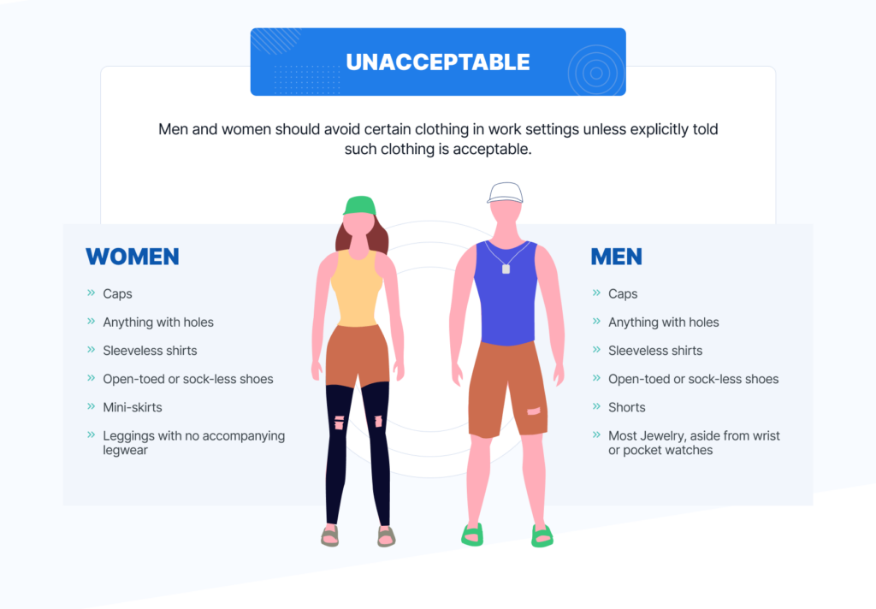
Unacceptable Dress Code

Slide 8
Why should employees follow appropriate dress code in the workplace?
Dress codes are used to communicate to employees what the organization considers appropriate work attire.
A dress code or appearance policy allows an employer to set expectations regarding the image it wants the company to convey.
Dress code create a respect for both employees and organization.

Slide 9
JEBAN IGNSH

